Slide 1
Let’s spend the money wisely!
Webinar Applicant’s Guide for the competitive call dedicated to Priority 2: A green region, Specific Objectives 2.4 and 2.7
14th of June, 2023 I Danube Plaza Hotel, Ruse
Financial issues

Slide 2
General information
The starting date of the eligibility of the expenditures is 1st of January 2021.
Types:
Project preparation (based on lump sum and real costs, if the case) - 14,000 euro (split between partners) + real costs
Staff costs flat rate (up to 20% from external expertise and services + equipment + infrastructure and works costs)
Travel & Accommodation flat rate (up to 15% from staff costs)
Office & administrative costs flat rate (up to 15% from staff costs)
Project closure lump sum - 6,500 euro (split between partners)
Real costs

Slide 3
Real costs
External expertise and services costs;
Equipment;
Costs for Infrastructure and works.
All real costs must be justified based on 2 offers or an independent evaluation of the prices.
In case the applicants do not submit the 2 offers to the evaluators (clarifications included, if applicable), nor an independent evaluation, if the case, then the respective amount may be reduced or deducted from the budget, according to their professional judgment.
In case the costs estimation is made on the data provided by a Feasibility Study/ equivalent documents (as foreseen by Annex B2), there is no need to provide 2 offers/independent evaluation for the items/services/works/investments covered by the Feasibility Study/or equivalent documents (as foreseen by Annex B2).

Slide 4
Budget of the call
Specific Objective 2.4
Indicative total allocation (includes the contributions from national co-financing and the own contribution of partners from both countries) – 9,126,637 Euro
Indicative ERDF allocation – 7,301,310 Euro
Specific Objective 2.7
Indicative total allocation (includes the contributions from national co-financing and the own contribution of partners from both countries) – 35,000,000 Euro
Indicative ERDF allocation – 28,000,000 Euro

Slide 5
Examples of eligible expenditures
External expertise and services: Studies or surveys (e.g. evaluations, strategies, concept notes, design plans, handbooks); Training; Translations; Development, modifications and updates to IT systems and website (strictly related to the project); Promotion, communication, publicity or information linked to the project; Participation in events (e.g. registration fees);
Equipment: office equipment; IT hardware and software; Furniture and fittings; Laboratory equipment; Machines and instruments; Vehicles;
Infrastructure and works: Purchase of land for an amount not exceeding 10% of the total eligible expenditure for the operation concerned; for derelict sites and for those formerly in industrial use which comprise buildings, that limit shall be increased to 15%; Building permits; Building material; Labour; Specialised interventions (e.g. soil remediation, mine-clearing).

Slide 6
Examples of non-eligible expenditures
fines, financial penalties and expenditure on legal disputes and litigation;
costs of gifts;
costs related to fluctuation of foreign exchange rate;
interest on debts;
costs for alcoholic beverages;
value added tax (‘VAT’), except:
for operations the total cost of which is below 5 million EUR (including VAT);
for operations the total cost of which is at least 5 million EUR (including VAT) where it is non-recoverable under national VAT legislation;
g) the purchase of land for an amount exceeding 10% of the total eligible expenditure for the operation concerned; for derelict sites and for those formerly in industrial use which comprise buildings, that limit shall be increased to 15%.

Slide 7
Financial sources
ERDF co-financing rate is 80%;
Romanian partners – the 20% of the national co-financing is ensured from the state budget (18%) and partner own contribution (2%);
Bulgarian partners - the 20% of the national co-financing is ensured from the state budget (18%) and partner own contribution (2%).

Slide 8
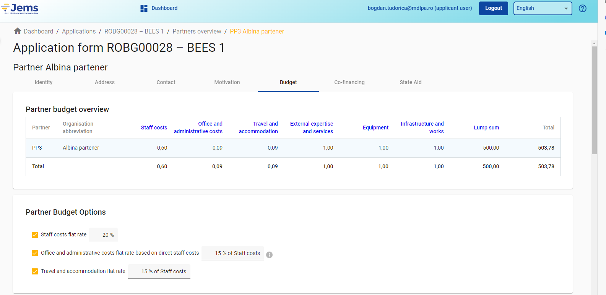
Budget

Slide 9
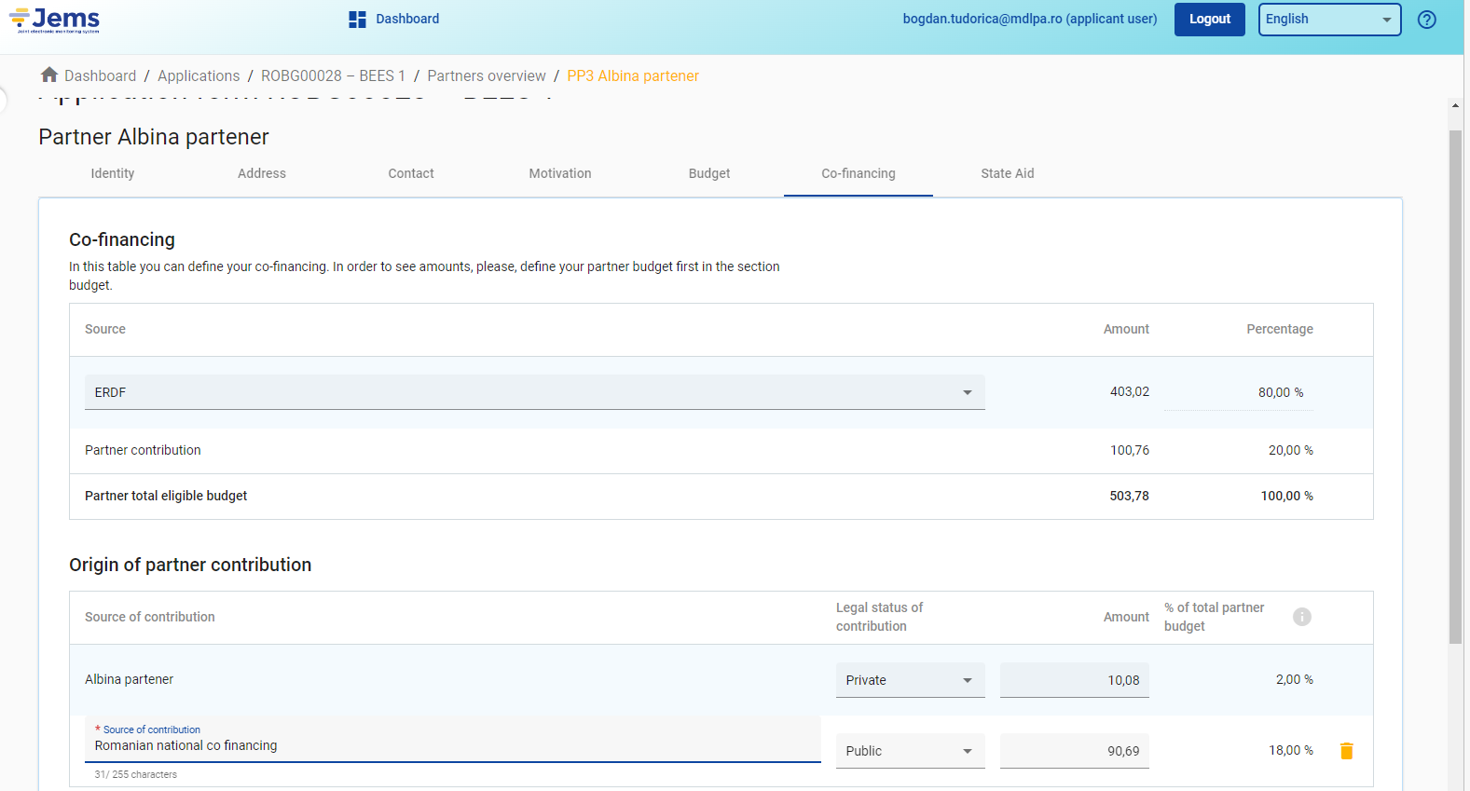
National Co-financing

Slide 10
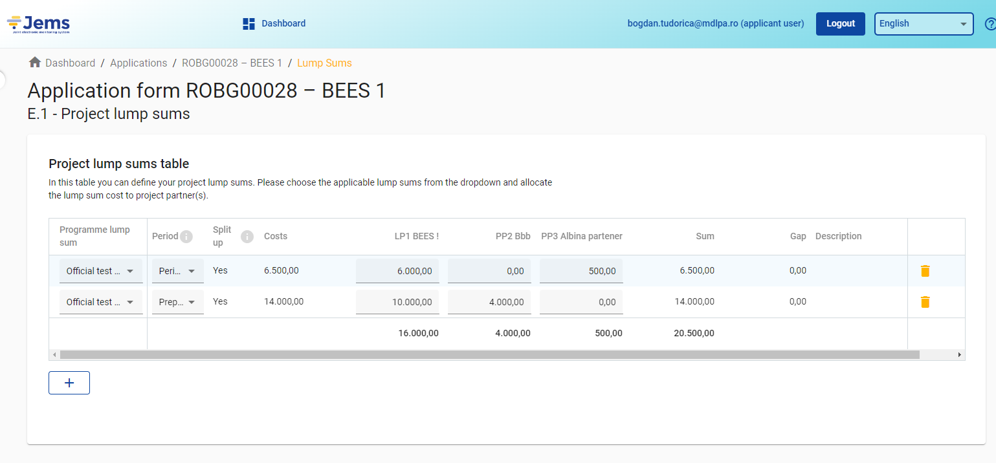
Lump sums

Slide 11
Reference documents:
Annex B List of eligible expenditure
Annex C Methodologies for using lump sums for project preparation and project closure within the Interreg VI-A Romania-Bulgaria
can be accessed on the Programme website here:
https://interregviarobg.eu/en/calls-for-proposals

